Slide 1

PM Weekend challenge #24
Content
HOBBY MATCH
Market Opportunity MVP wireframes
Techstack
Go to Market Strategy
Your one stop destination to unleash your Hobby
Subhadip Samanta
IIFT Delhi

Slide 2



HOBBY MATCH
About
Hobby match is an app to help anyone who wants to learn or improve his skill on anything to connect with teachers nearby or anyone who wants to share his/her skill can invite people for their class.
Goal
To create a MVP of this app for a soh launch. As it's a soh launch I will target Bangalore area.
Competitor app
Hobby Hunt

Slide 3
Market Opportunity
Market Behaviour
Almost everyone has a hobby as a passion, leisure or relaxation.
Due to the COVID pandemic it has been observed that people have developed a interest in some or the other hobby or crah to ﬁll their days. Example Baking, Dancing, playing instruments etc
Skilled People also got a great opportunity due to a lot of free time to share their skills and add in a source of income during these trying times.
Infact this was a creativity calamity as people were looking forward to add new skills to their proﬁle and they are not hesitant to enroll themselves to special classes too.
If not for Covid, people otherwise also take some time out for their hobby.
https://economictimes.indiatimes.com/after-hectic-hours-executives-find-fun-at-hobby-classes/articleshow/2888341.cms and https:// www.theguardian.com/business/2020/aug/03/hobbycraft-reports-boom-in-online-sales-since-start-of-pandemic-crafts-coronavirus

Slide 4
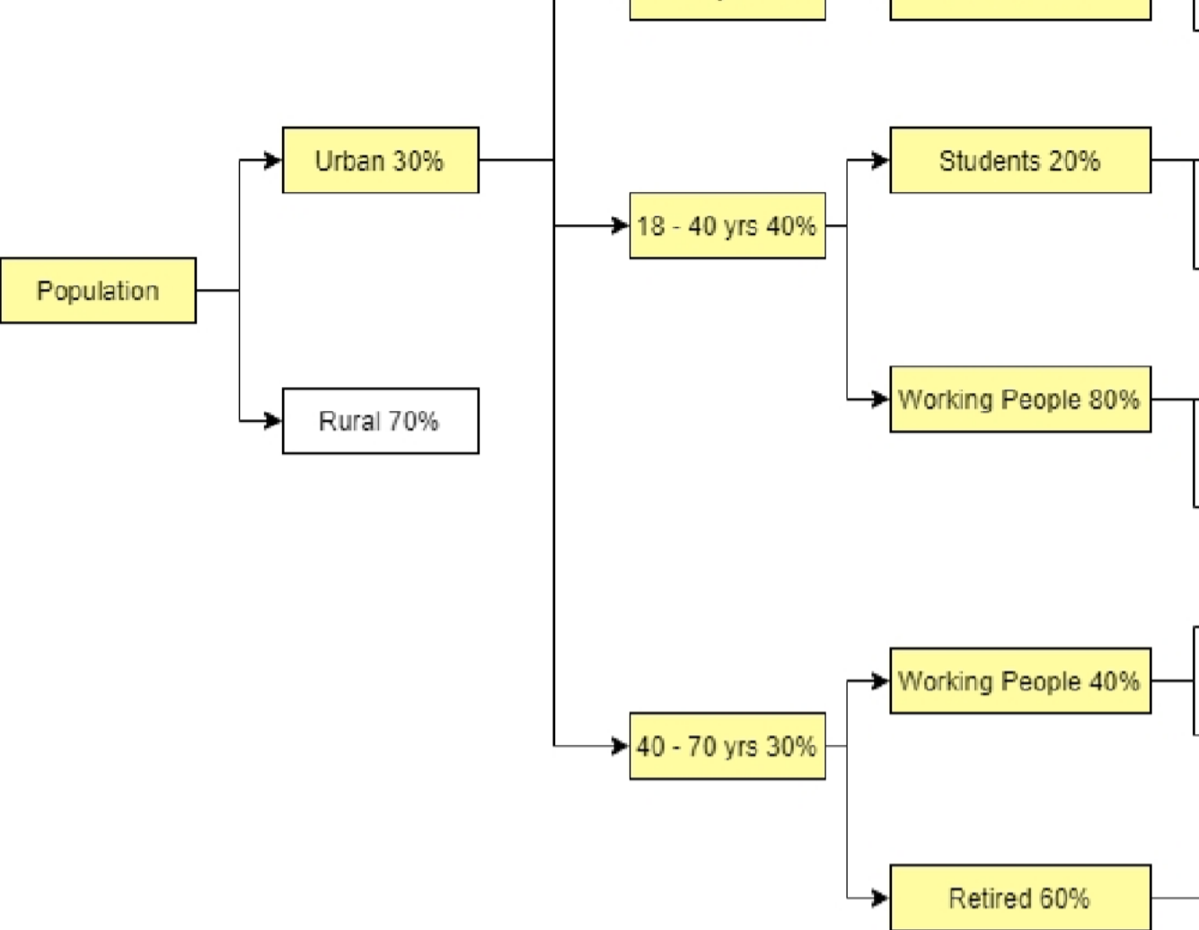
Market Size
Note: I have considered here Bangalore population as we will have a soh launch.
*boxes marked in yellow are the addressable market.

Slide 5
Total Bangalore Urban population 1.26 cr
3 18 years old
20% of 1.26 cr = 3780000
Out of which Students are 90 % of 3780000 3402000
Out of which 10% would like to teach = 10% of 3402000 340200 Out of which 40% would like to learn = 40% of 3402000 1360800
18 40 years old
40% of 1.26cr=5040000
Out of which students are 20% of 5040000 1008000
Out of which 30% would like to Teach= 30% of 1008000 302400 Out of which 50% would like to learn= 50% of 1008000 504000
Working Professionals are 80% of 5040000 4032000
Out of which 30% would like to Teach= 30% of 4032000 1209600
Out of which 40% would like to learn= 40% of 4032000 1612800
40 70 years old
30% of 1.26 cr =3780000
Working professionals are 40% of 3780000 1512000
Out of which 30% would like to Teach= 30% of 1512000 453600 Out of which 10% would like to learn= 10% of 1512000 151200
Retired people are 60% 3780000 2268000
Out of which 40% would like to teach= 40% of 2268000 907200
Market Size= 68,41,800

Slide 6

Features In MVP
User sign up using Mobile number and OTP
User enters hobby to learn or teach a skill.
Based on users location and personalized hobby result, match can be created to ﬁnd teacher or student.
User can accept or reject requests or invites based on interest.
User can check teachers or students proﬁle. For teachers we can also check review and past classes videos conducted.
Once request is accepted students can chat with their teachers or create group chats.

Slide 7
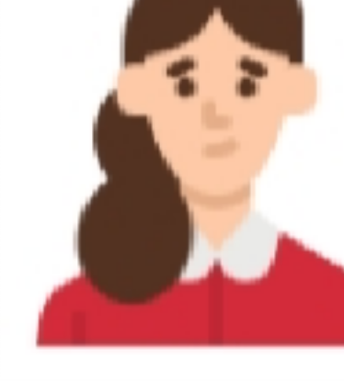


User Personas
38 yrs old Vrunda Desai has a 5 year old son.
45 yrs old Rajesh Mittal works in a software company.
30 yrs old Hareesh Phal is a sales rep.
She wants to enroll him in violin class nearby.
He always wanted to learn swimming.
He is looking for a big promotion for which he should know French.
She is looking for a verified teacher.
Finally he has planned to learn swimming post office hours or on weekends.
He is looking for a French tutor.
As a typical mother she would like to get to know the tutor before enrolling her son.
As he has a 9 7 job he is looking for a nearby tutor.
Hareesh is also good in swimming and would also like to conduct swimming classes.

Slide 8
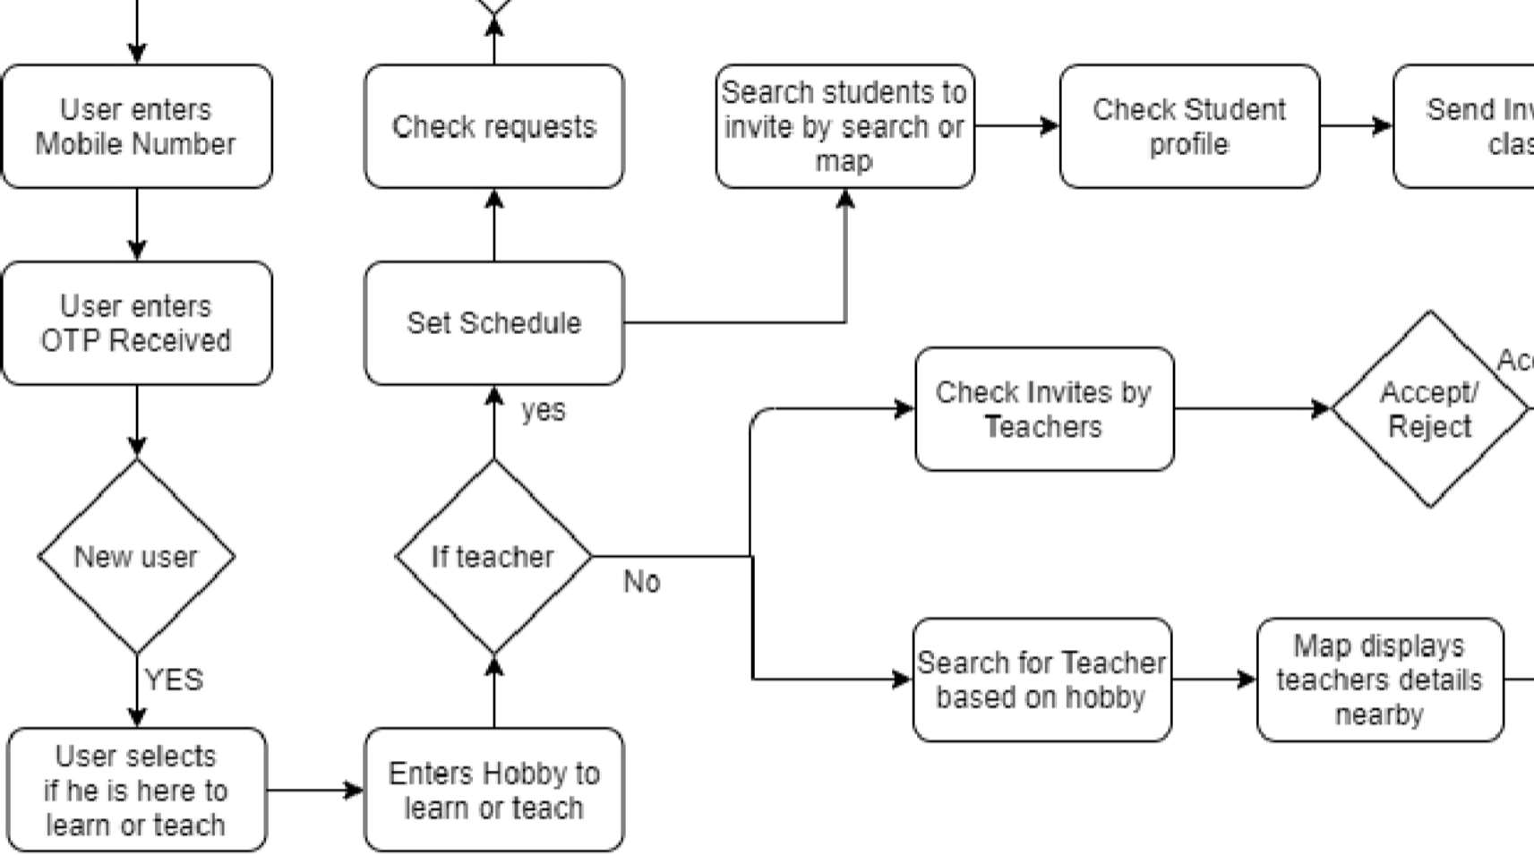
User Journey

Slide 9

Wireframes
This is your value proposition
page, which appears when you first download the app.
Here CTA is to add mobile number to complete sign up process.
HOBBY MATCH
HOBBY MATCH
Mobile number
Your one stop destination to unleash your Hobby
For the sign up and sign in process we will just use mobile number and if we identify a new user we will show on boarding page as
next steps
1 | 2 | 3
4 | 5 | 6
7 | 8 | 9
 | 0
Enter Mobile Number
On boarding Screen
Sign in / sign up screen

Slide 10

Verification and on boarding
Enter OTP
+91 55555 55555
What do you wish to do with Hobby Match?
I want to learn a new hobby
Not received OTP yet?
Resend OTP
Your account has been verified successfully!!!
Only for new users
1
2
3
I want to teach my skills to students
4
5
6
7
8
9
I wish to do both, learn & teach.
0
OTP verification screen for all user types
User verified screen loads and closes after few seconds

Slide 11

User hobby details
Add a hobby you want to learn
Add a hobby you want to Teach
Add Schedule
Enter location
Enter hobby
Enter hobby
DD/MM/YYYY
Enter category
Enter category
Start Time
End Time
08 |  | 00 |  | 09 |  | 00
09 |  | 00 |  | 10 |  | 00
10 |  | 00 |  | 11 |  | 00
Violin
Drawing
Singing
Violin
Drawing
Singing
Baking
Cooking
Baking
Cooking
Save changes
Add Schedule (Optional)
Set repeat mode
Save changes
Save
User who wants to learn or both will get this screen
User who wants to Teach or both will get this screen
Set schedule screen for teachers

Slide 12


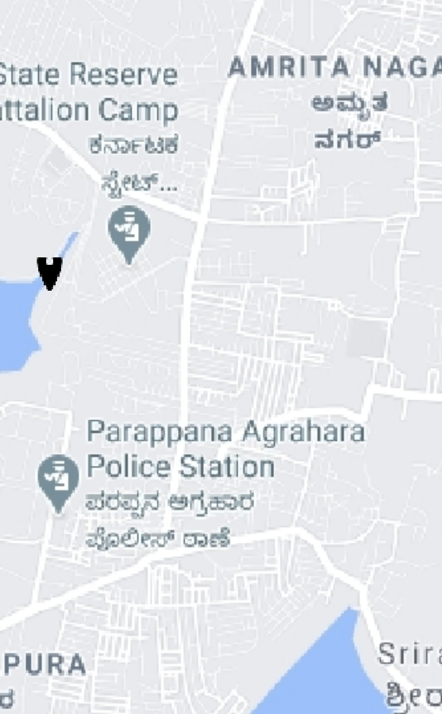






Screen for User who wants to learn (Rajesh Mittal)
Hobby Match
Swimming
Map
My Hobbies Invites Teacher Match
Swimming
1 Match
Hareesh Phal
Once user looks for a match, his location details will be taken
Remove
Request Lesson
Hareesh Phal
Remove
Request Lesson
Teach
Home
Learn
Chat

Slide 13












Screen for User who wants to Teach (Hareesh phal)
Hobby Match
Hobby Match
Swimming
My Hobbies Requests
My Hobbies Requests
Hareesh Phal
Reject Accept
Swimming
Sports
Swimming
10 Requests
Hareesh Phal
Reject Accept
Hareesh Phal
Reject Accept
Hareesh Phal
Reject Accept
Teach
Home
Learn
Chat
Teach
Home
Learn
Chat

Slide 14

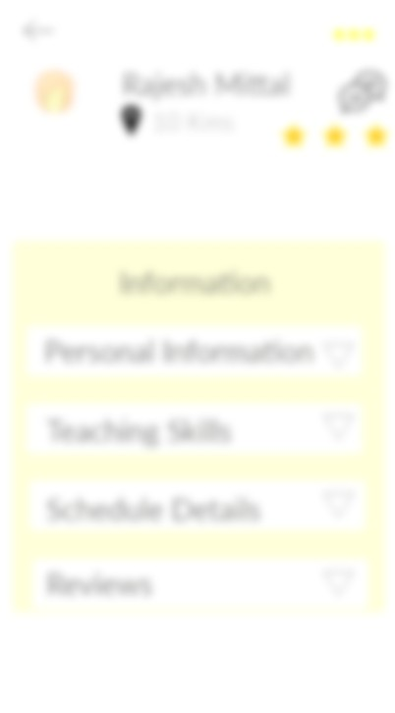









Rajesh Mittal
Rajesh Mittal
10 Kms
Information Personal Information
Teaching Skills Schedule Details Reviews
10 Kms
This is the user information page which shows user name, distance, ratings, personal information, reviews etc. One can also initiate a chat from this page.
Reject
Accept
Information
Personal Information
Hobby / Skills
On click of the 3 dots, following modal will open from which a teacher can send an invitation to student.
Invite to Lesson
Class Videos
Cancel
Reviews
Write a Review

Slide 15












Other screens
Search
Chat
Hobbies
People
Messages
Groups
Hareesh Phal
Search
My Students
Vrunda Desai
Vrunda Desai Hello
2:00 PM
My Teachers
Settings
Suggestions
Support
Log Out
Teach
Home
Learn
Chat
Teach
Home
Learn
Chat
Teach
Home
Learn
Chat
Search screen
Chat Screen
Navigation menu

Slide 16







Tech Stack
Mobile app framework
Cloud
Database
Chat / message plugin
Google Maps api

Slide 17
Go To Market Strategy
User Acquisition and retention
Promote app through social media inﬂuencer/ social awareness leading to rapid increase in new users.
For ﬁrst 100 users provide 50% oﬀ for ﬁrst class of the hobby session.
Users like to go to veriﬁed teachers hence, by giving reviews and videos of classes by teachers safety factor is taken care of.
Optimize discovery of app through app store or play store optimization. For retention, promote referral program with special oﬀers.
Pricing Strategy
Organize Events generate revenue through entry fees
Allow maps and chat free for 7 days and aher that users have to subscribe Revenue collection from the advertisement in the app

Slide 18
Success Criteria
Goals
Signals
Metrics
Happiness
User Satisfaction
App Rating, Review
NPS, average app rating
Engagement
User Personalising Hobby
Time spent on app
Total class per user
Adoption
User Onboarding
Download rate
Number of reviews of users
Retention
User Loyalty
Uninstall rate
Monthly retention rate
Task Success
User Goal Completion
Total value of Subscriptions
No. of class and reviews

Slide 19


